Slide 1
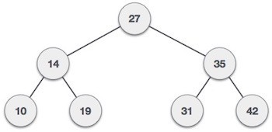
Binary Search Tree
λ
Binary Search tree exhibits a special behavior.
A node's left child must have a value less than its parent's value and the node's right child must have a value greater than its parent value.
λ

Slide 2
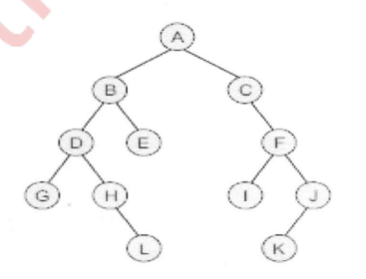

Slide 3
^{λ} BST Basic Operations
The basic operations that can be performed on a binary search tree data structure, are the following −
λ
Insert − Inserts an element in a tree/create a tree.
Search − Searches an element in a tree. Preorder Traversal − Traverses a tree in a pre-
order manner.
Inorder Traversal − Traverses a tree in an in-

Slide 4
^{λ} Implementation of Binary Search
Tree

Slide 6


Slide 7
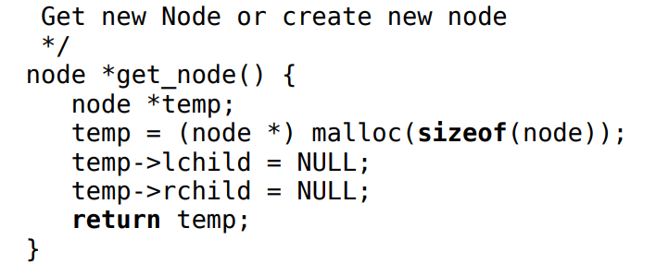

Slide 8
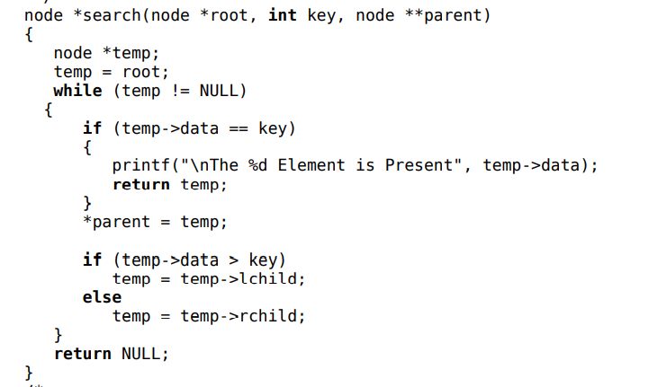

Slide 9
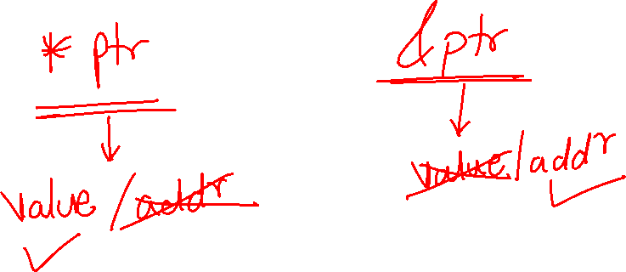

Slide 10
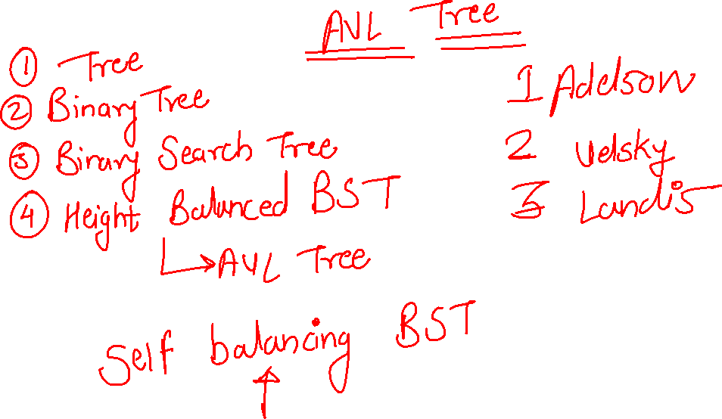

Slide 11
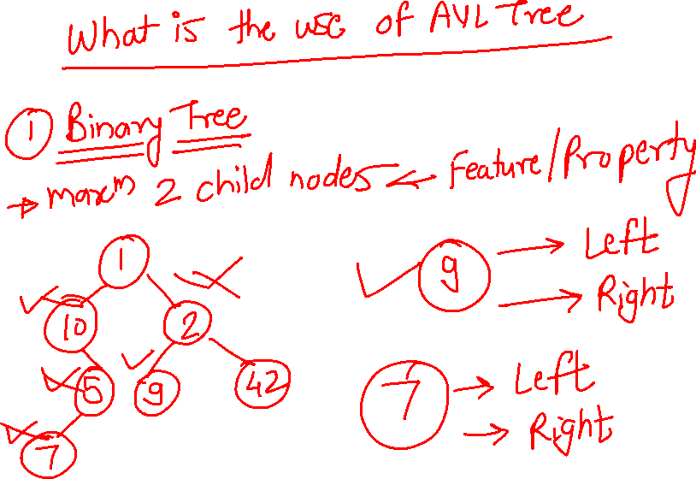

Slide 12
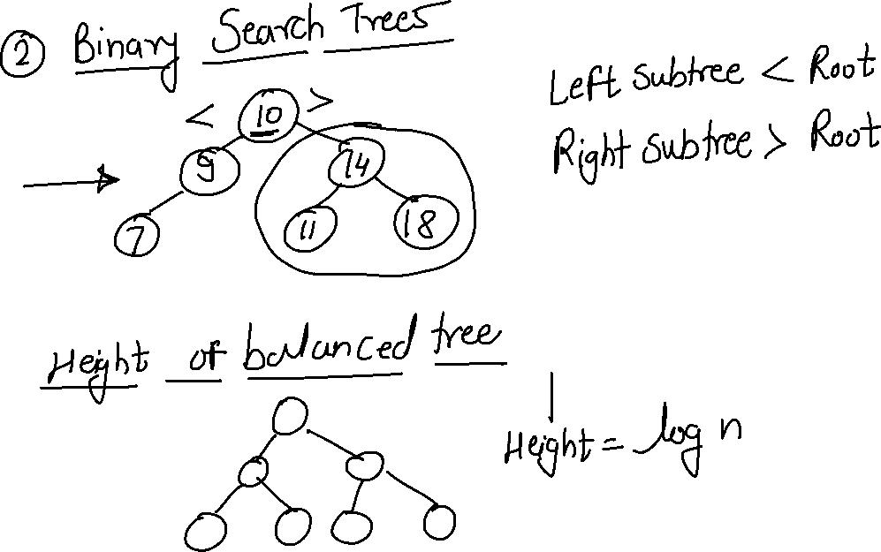

Slide 13
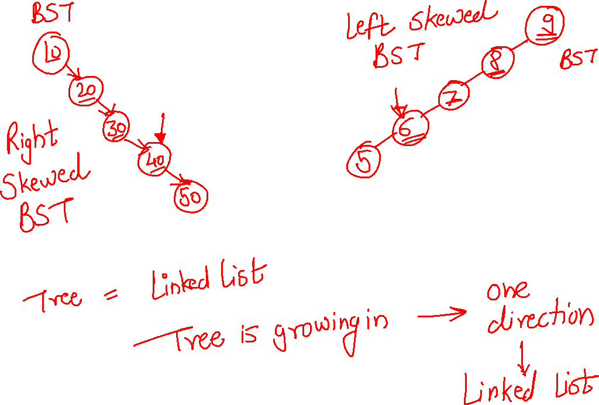

Slide 14
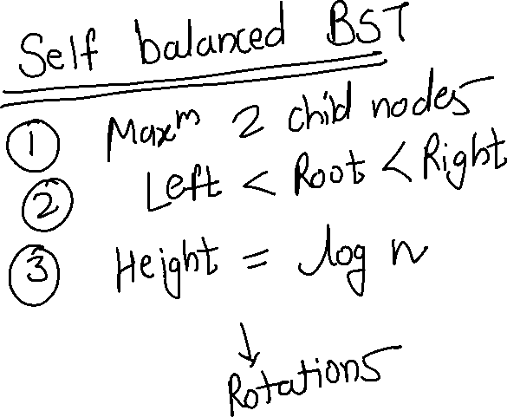

Slide 15
